Slide 1
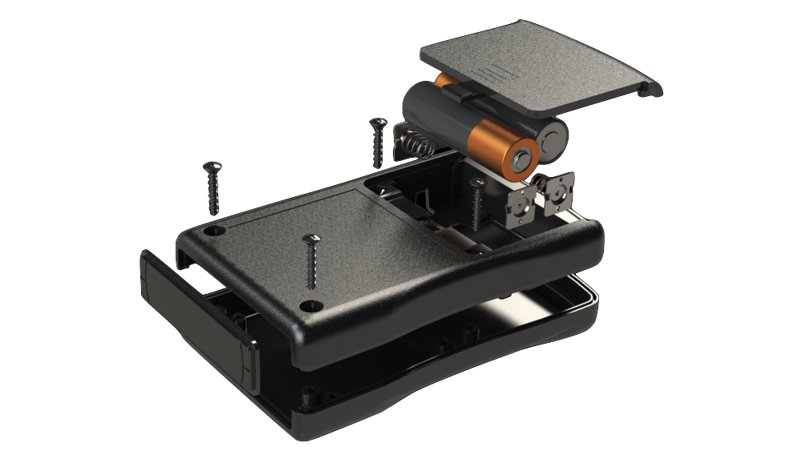
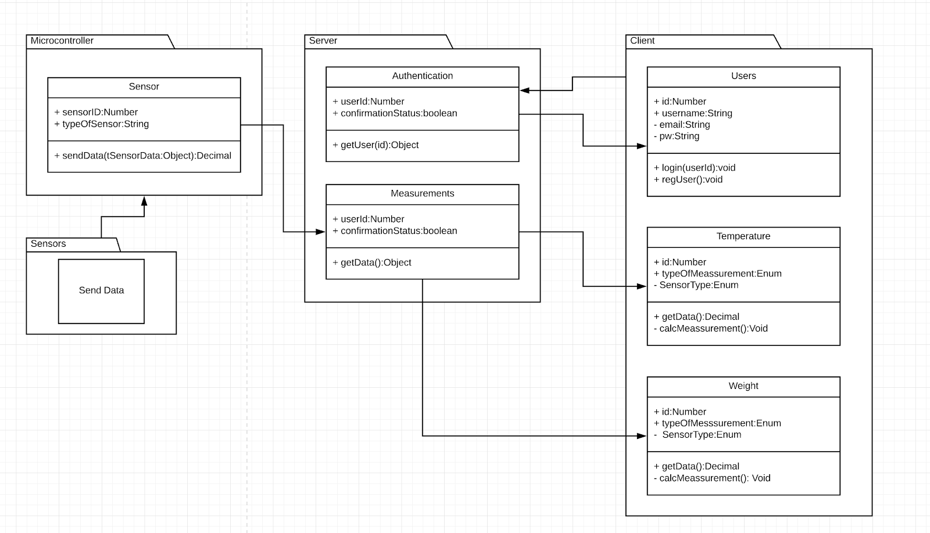
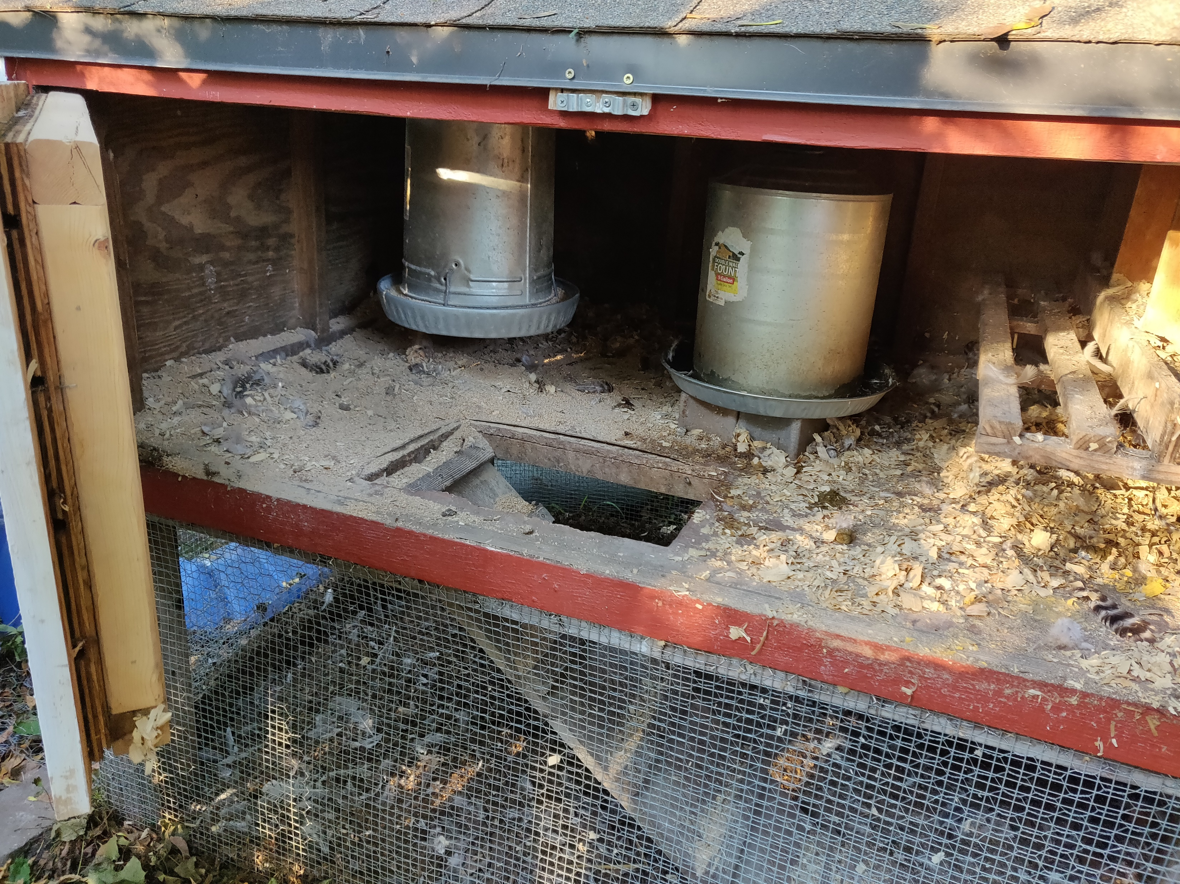
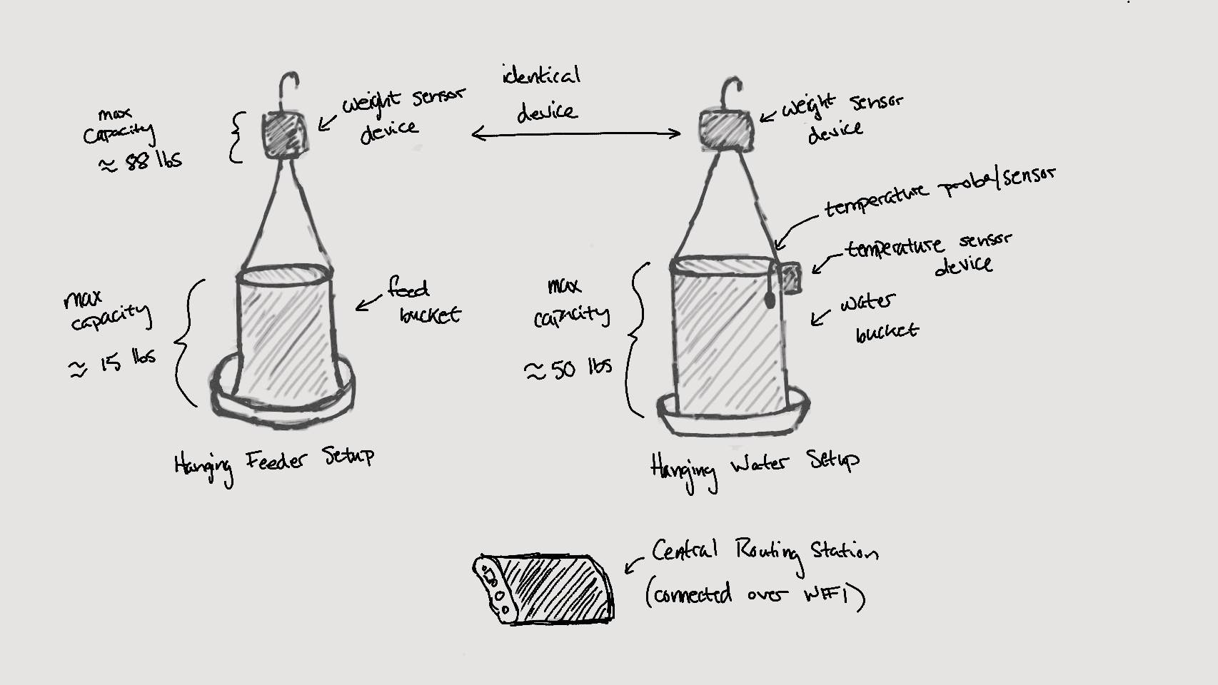
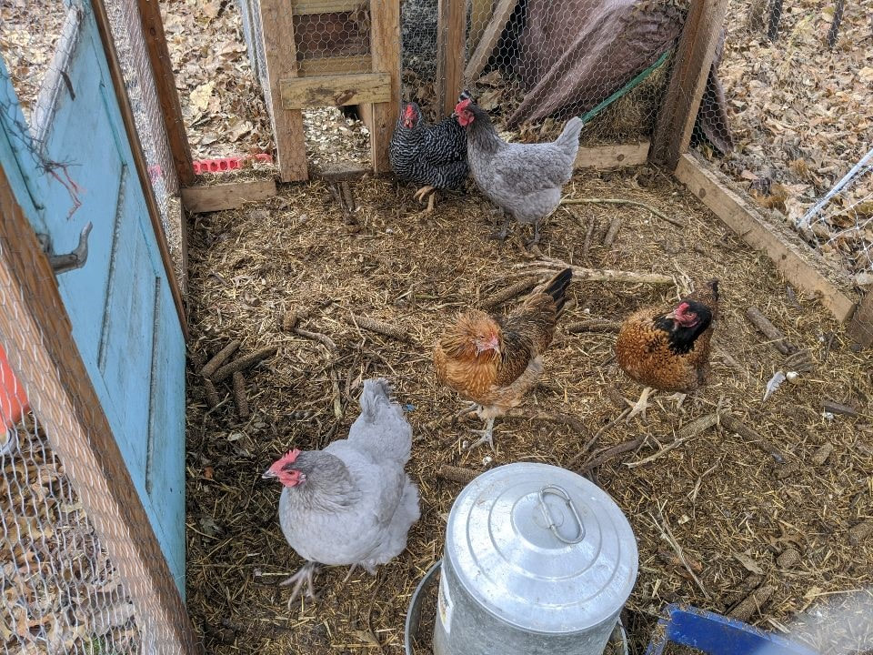
Wireless Backyard Chicken Food and Water Monitor
Alexander Lewoczko, Alexander Goldyuk, Amine Hocine, Armando Vila-Colon, Lexi Reicks, and Ryan Toepfer
Class of 2020 - http://sdmay20-55.sd.ece.iastate.edu/ - Special Thanks to Professor Andrew Bolstad
Introduction
Raising chickens and other poultry for eggs in backyards is an increasingly popular hobby. Ensuring the chickens are healthy requires monitoring their water and food supply.
The goal of this project is to design and build a wireless water/feed sensor to report when water cans and feeders are empty. The solution will consist of sensors that will monitor water and feed levels, and Wi-Fi capabilities to report this information to a webpage or mobile application.
Design Approach
Our proposed design consists of hardware to read sensor data from the deployed microcontroller and send this data to a database running on the server. A web application will also be created to allow the client to view this data in relative real-time. To satisfy the base requirements, there will be three sensors in total, consisting of two weight sensors and one temperature sensor. Each weight sensor would be respectively used to monitor the weight of the water and the weight of the feed. The temperature sensor would then be used to specifically monitor the temperature of the water, ensuring that it is above the freezing point. The weight sensors will be attached to the feed and water containers and hang from the ceiling, indicating how much feed and water is available and if the containers need to be refilled. This information will be used to display graphs and make predictions about the feed and water use. The web application will mainly need to send alerts if the feed or water falls below a certain configurable threshold, or if the water is reaching the freezing point.
Testing
Our software testing strategy involves integration testing over unit testing. We made this decision as a web team since the internal application logic is not algorithmically complicated. Because of this, individual testing methods are unlikely to be helpful. Instead we have opted for a broader scope, such as externally triggered integration tests, manual test scripts, and a test database that contains fake data.
Testing of hardware will covers three main topics; battery life, sensor accuracy, and signal propagation. This is accomplished using a combination of field testing and lab testing using external data loggers as well as datalogging capabilities built in to the EPS32.
Design Requirements
Functional
Device must measure water temperature within one degree Fahrenheit.
Device must measure food and water levels within half of a pound.
Device must connect via customer’s home Wi-Fi network
Non-Functional
Device must cost under $200
Device should have low power consumption to maximize battery life
Data and network security
Operating Environment
Device must be water resistant
Device must operate in expected seasonal Iowa temperatures
Device must not injure chickens
Technical Details
We selected the SparkFun “ESP32 Thing” for the microcontroller that will be used in our device. This model was selected for multiple reasons which include support of the existing Arduino IDE, on-board wireless capabilities, on-board battery charging capabilities, low power consumption, small footprint, and low cost. For our sensor suite, we chose a Degraw 40 hanging load cell and a DS18B20 temperature sensor package, which allows for remote measurement of temperature of up to 6 feet away. For our database, we decided on MongoDB, a document database that requires little set up, has an easy schema design, and is suitable for projects that require little to no relations. Flask and Python were chosen to go along with MongoDB because they are very lightweight and are readily compatible.
Engineering Standards and Design Practices
P16085 - ISO/IEC/IEEE International Draft Standard - Systems and Software Engineering - Life Cycle Processes - Risk Management.
IEEE 2430-2019 - IEEE Trial-Use Standard for Software Non-Functional Sizing Measurements.
Intended Users
The key demographic of our product is the home chicken hobbyist who wishes to better monitor the resource usage of their chickens. Our aim is to provide a very simple interface for this monitoring as we do not expect the user to have any solution-specific software or hardware experience.

